Slide 1
Data Journalism
Teemo Tebest, EBU
Notes:
INTRODUCTION

Slide 2
Teemo Tebest
Data Journalist since 2011
Worked at Yle Plus Desk, a team of 8 people including graphic designers and coding journalists
Huge success: most read stories, international prices, leading the industry
Driving the change towards online platforms
See: plus.yle.fi

Slide 3
What is EBU
The European Broadcasting Union is an alliance of public service media organisations, established on 12 February 1950.
See: ebu.ch

Slide 4
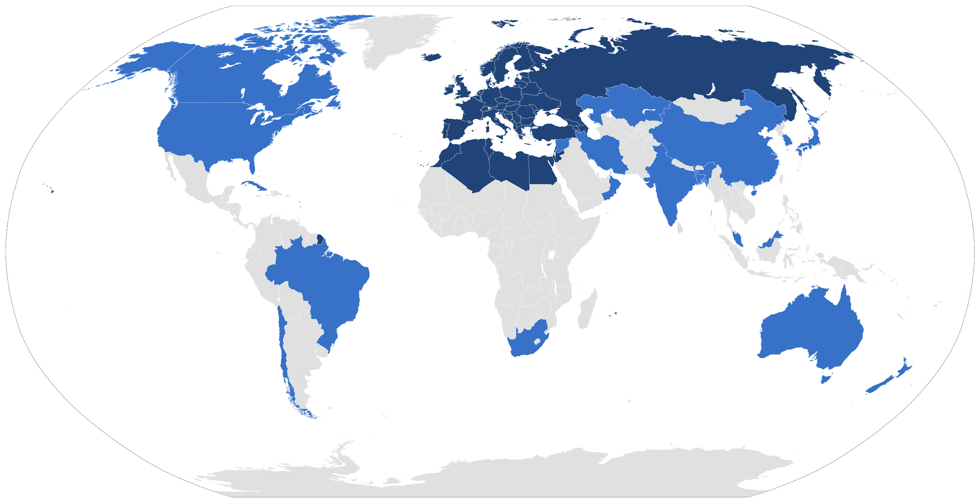
News Exchange
Sharing content between members
See: news-exchange.ebu.ch/

Slide 5
Social Newswire
Sharing User-generated content to the members.
See: www.evnsocialnewswire.ch

Slide 6
Investigative Network
See: A network of investigative journalists.

Slide 7
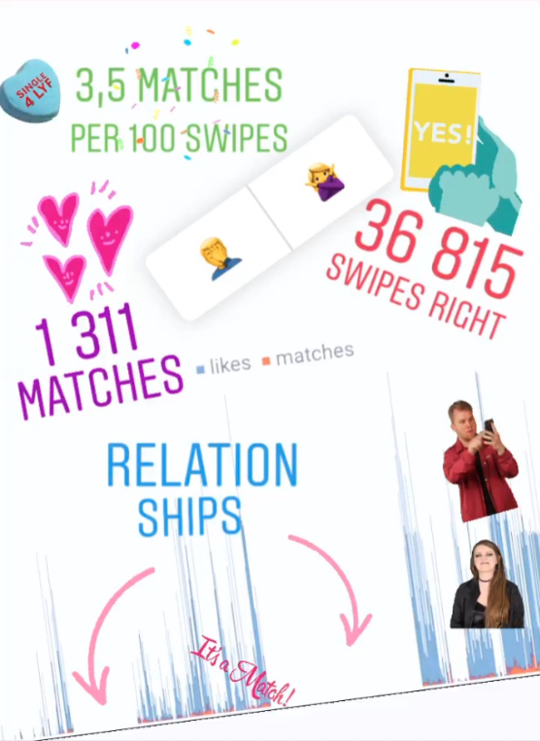
Data Journalism?
Data is everywhere
Data journalism is a journalism specialty reflecting the increased role that numerical data is used in the production and distribution of information in the digital era
Infographics
Data-driven Journalism
Data Visualisations
Interactive Visualisations
News Games
Source: Wikipedia

Slide 8
Why?
Data is everywhere
EBU is responding to the ever changing media landscape
Shift towards online platforms
New ways of telling stories
Help the members to catch up with data journalism
Support of cooperation between members on new technology

Slide 9

What?
Visiting SRF data team
Creating and expanding the community and awareness
Providing data journalistic content for the members to use
Encouraging and supporting cooperation between members including an exchange of data stories from one member to another

Slide 10
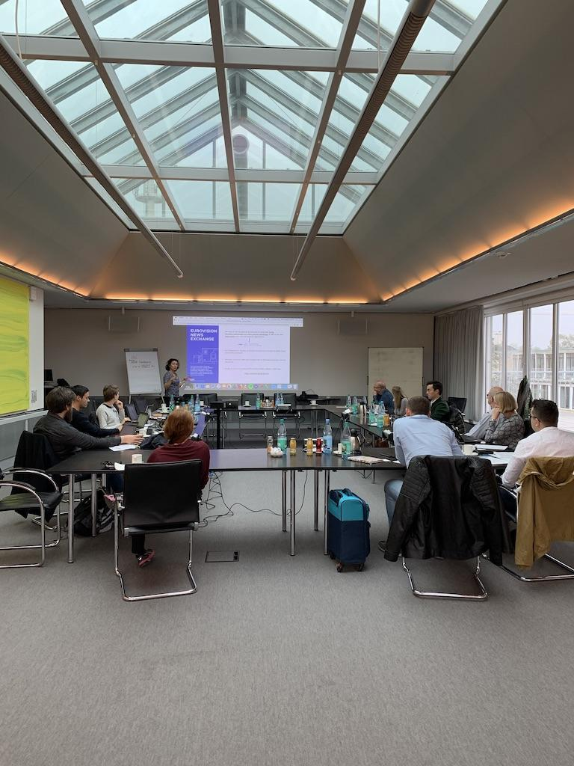
Building the Community
Hamburg workshop
We have a Facebook group which is used to share stories, share ideas and share knowledge between members
People from Lithuania to Marokko and from Sweden to Italy
In September we organized an event in Hamburg with the help of NDR
See: www.facebook.com/groups/ebudatajournalists/

Slide 11

Data Stories
News Exchange
We have introduced a collection of data story templates for the members to use
We provide data stories via the News Exchange and the Social Newswire
We need to raise the awareness of this service
See: github.com/ebuddj
See: news-exchange.ebu.ch/data-journalism

Slide 12
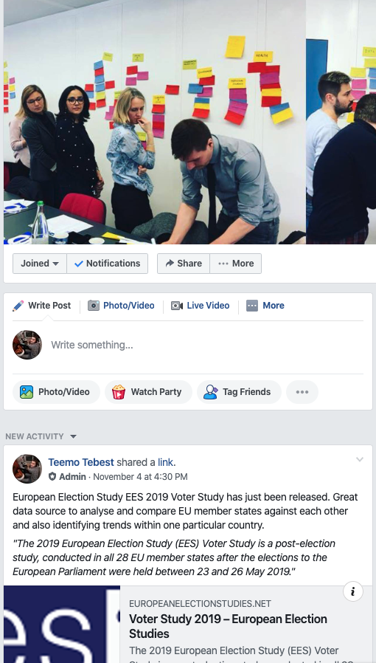
Cooperation
Facebook group
We are encouraging and asking members to share what they have done
Sharing stories and experiences on Facebook
Cross-border projects are encouraged
Possibilities for cooperation are limitless and we are trying to find the best ways to do it
Cooperation between members but also between members and EBU

Slide 13

Next steps?
We want to grow and activate the community and contact the members individually in the near future
We are also keen to provide even more content for the members
We have plans to work together with the EBU Academy to provide training of data journalism
We are investigating the possibility to start a data journalists exchange

Slide 14


FOLLOW THE EBU
@teelmo Teemo Tebest
@EBU_HQ
facebook.com/EBU.HQ
linkedin.com/company/ebu
instagram.com/ebu_hq/
EBU UPDATE monthly newsletter

